Slide 1
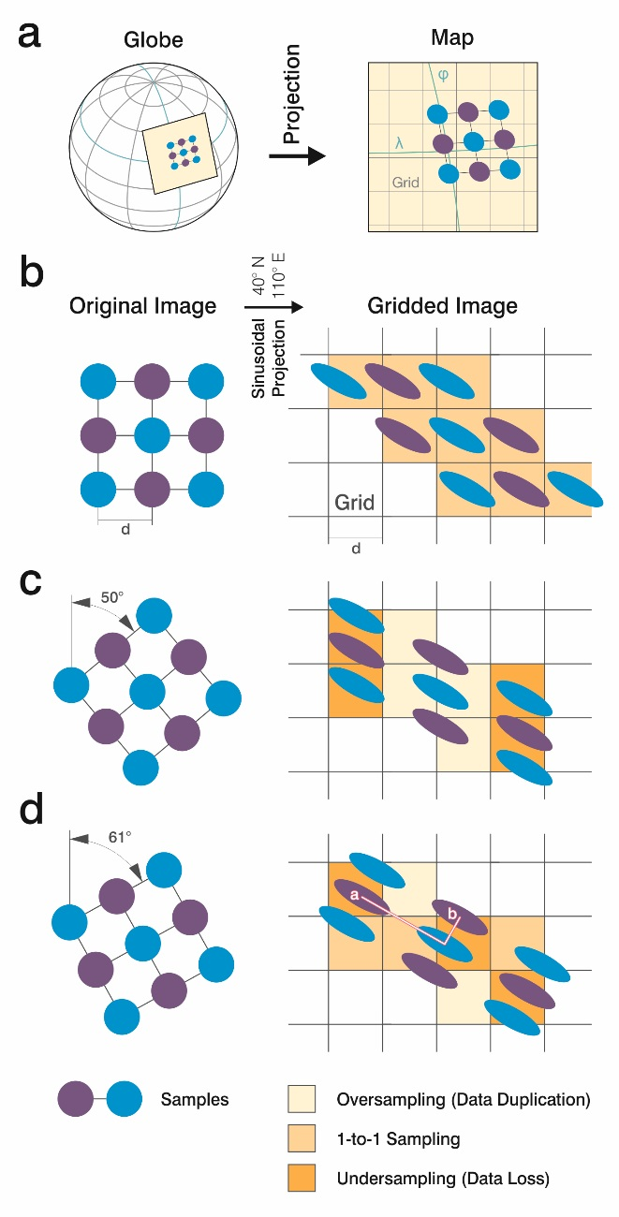
The Equi7 Grid: Motivation
High resolution satellite imagery
should be stored efficiently
should be stored geometrically correct
global map projection distort the images
oversampling
data volume!
neighbourhood relationships disordered
accuracy!

Slide 2
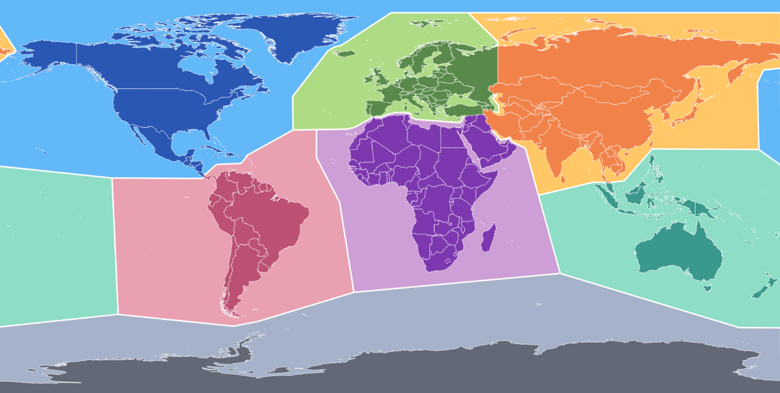
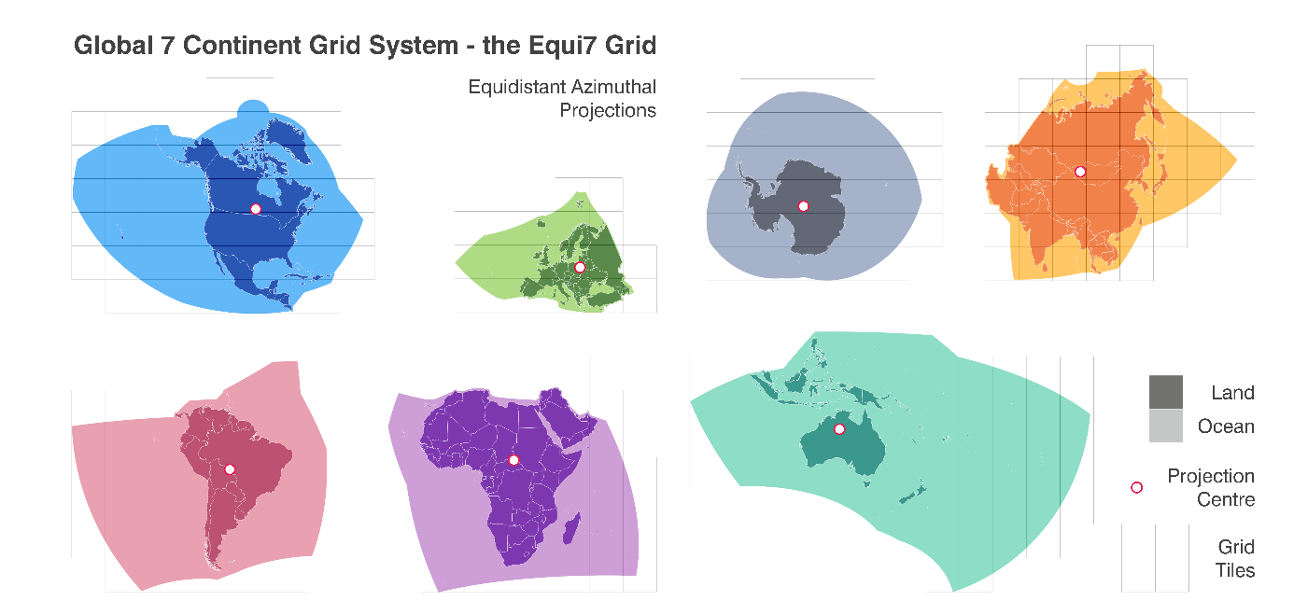
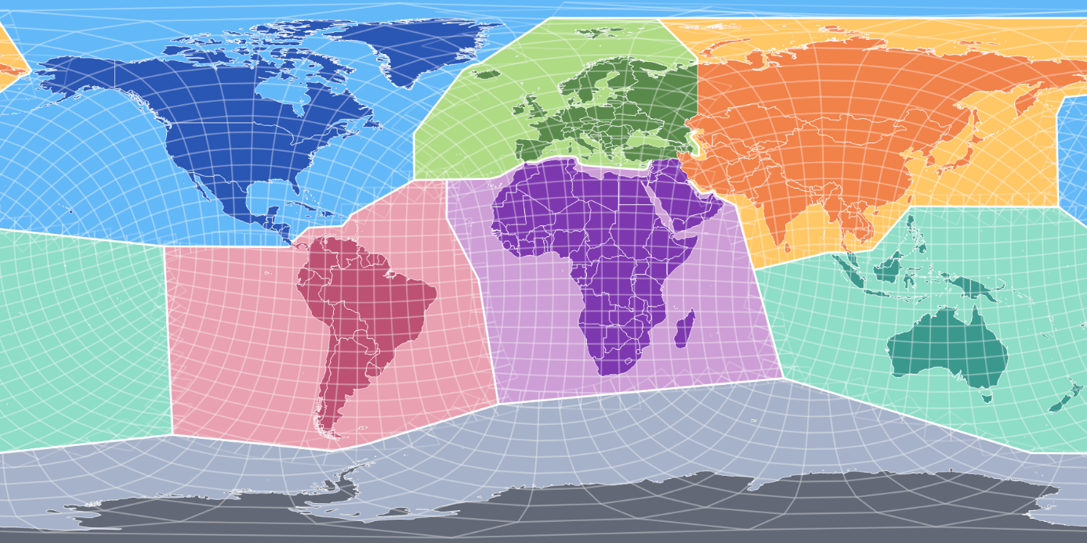
Equi7 Grid: 7 continental zones: individually projected & tiled

Slide 3
Equi7 Grid: Setup
optimised for image data over land
7 geographical zones (=subgrids)
Azimuthal Equidistant projections (minimum distortion)
50km overlap over land
5 resolution layers per subgrid
point sampling distances: 500/75/40/10/5 m
3 tile sizes
co-located arrays of 600/300/100 km image tile frames
free-2-use software
python code
ESRI shapefiles

Slide 4
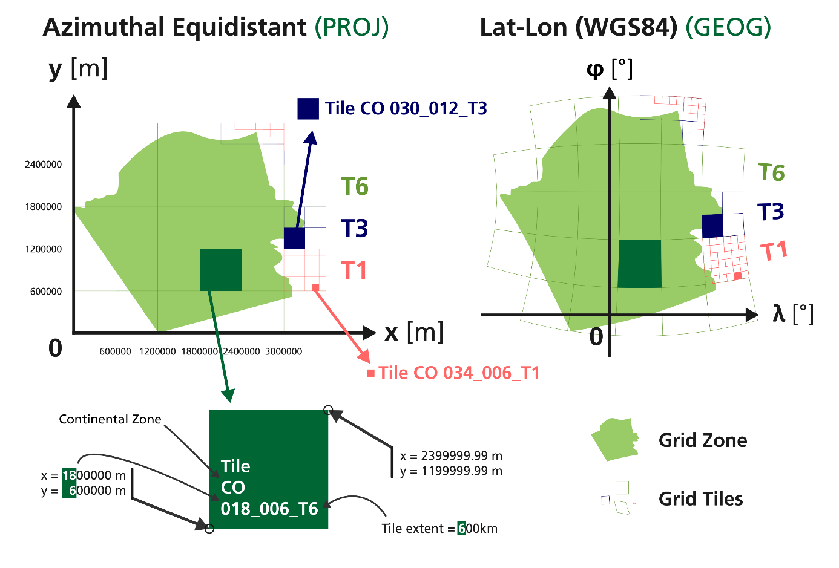
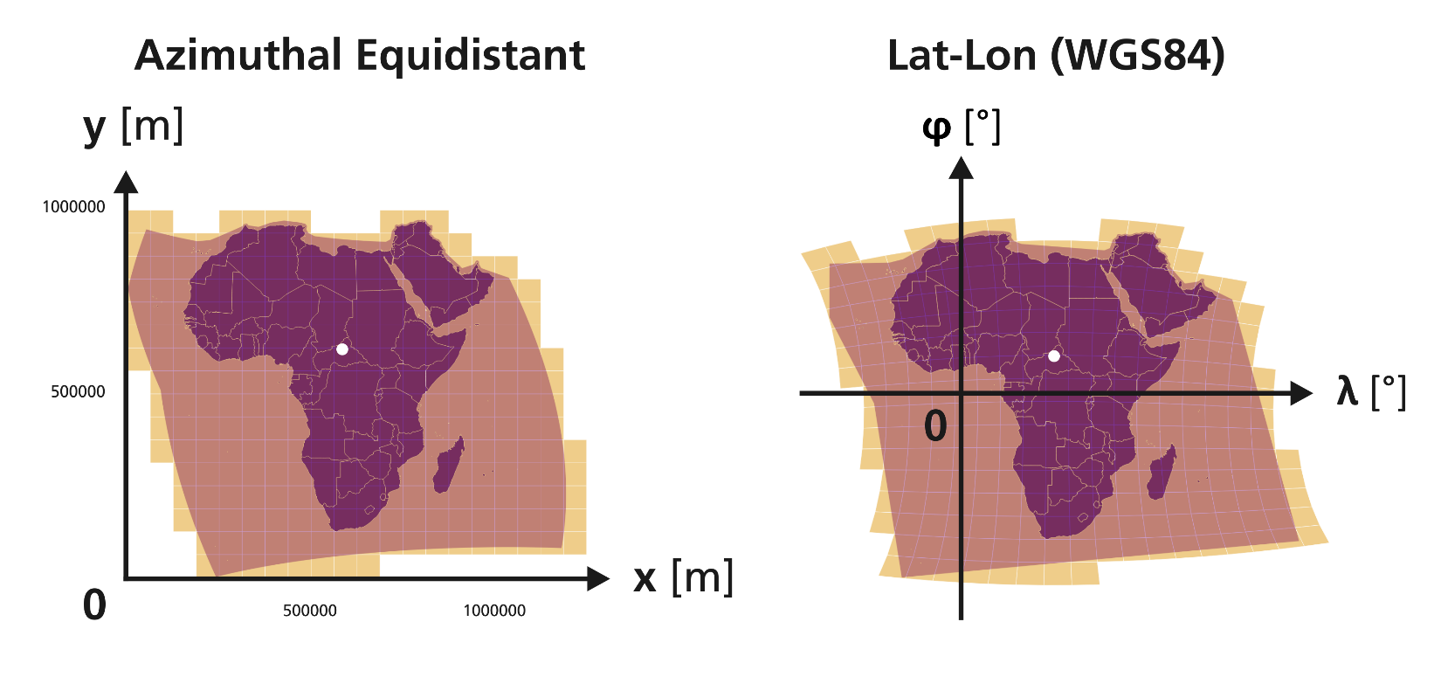
Equi7 Grid: Tiling

Slide 5
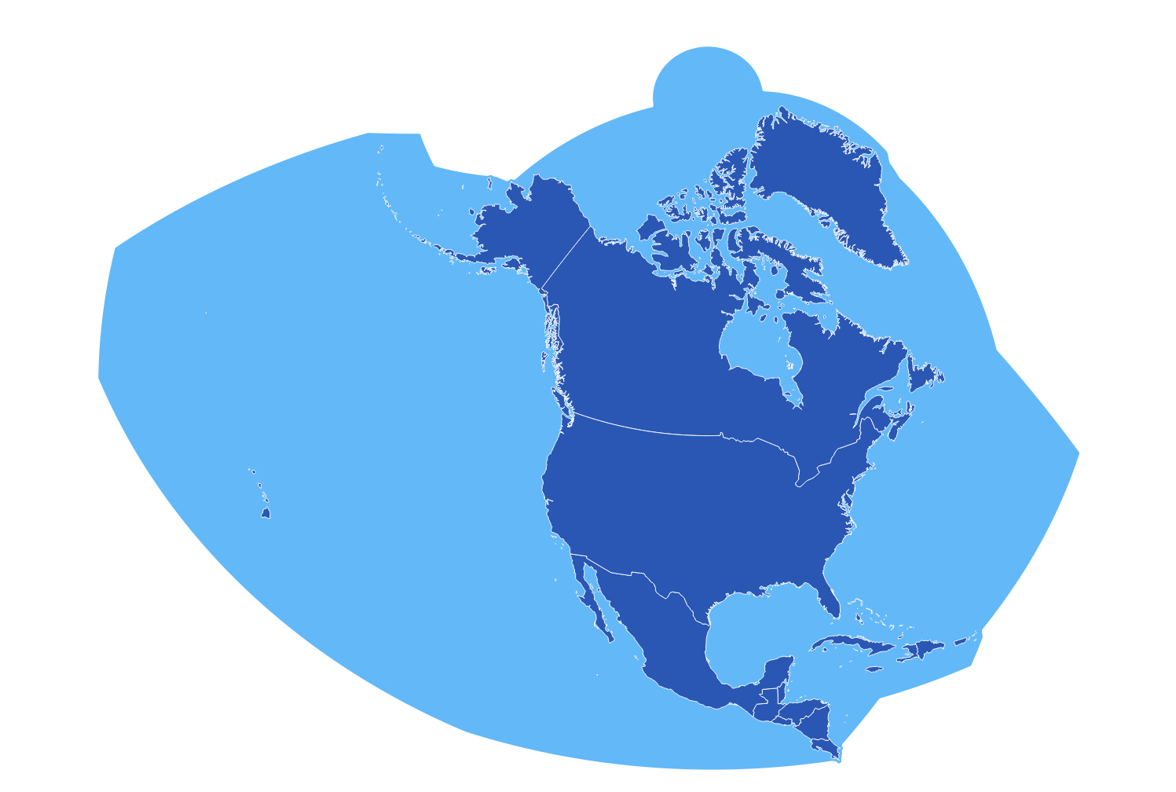
Equi7 Grid: Tiling: 3 Levels

Slide 6
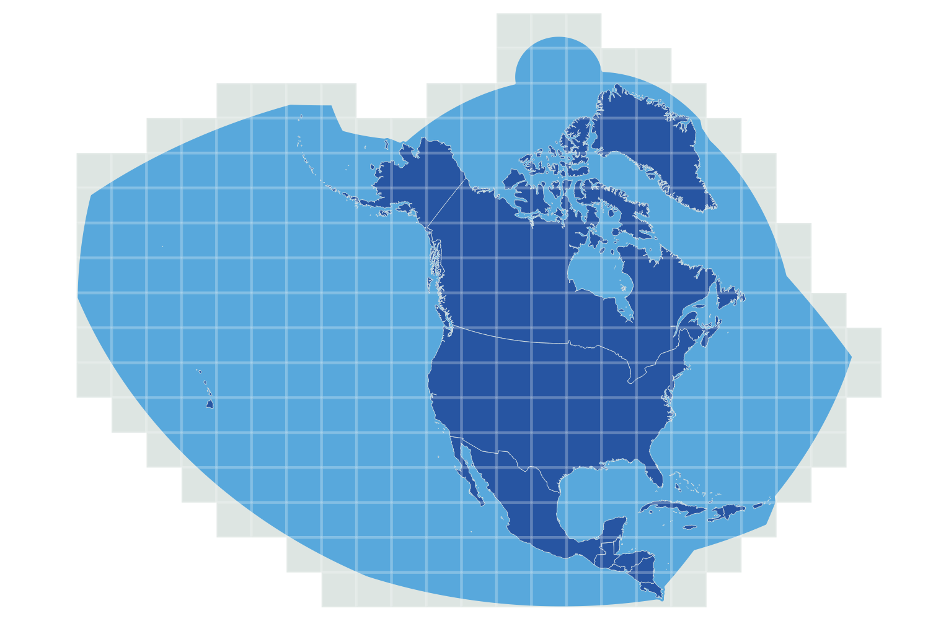
Equi7 Grid: Tiling: T6: 600km for 500/75m

Slide 7
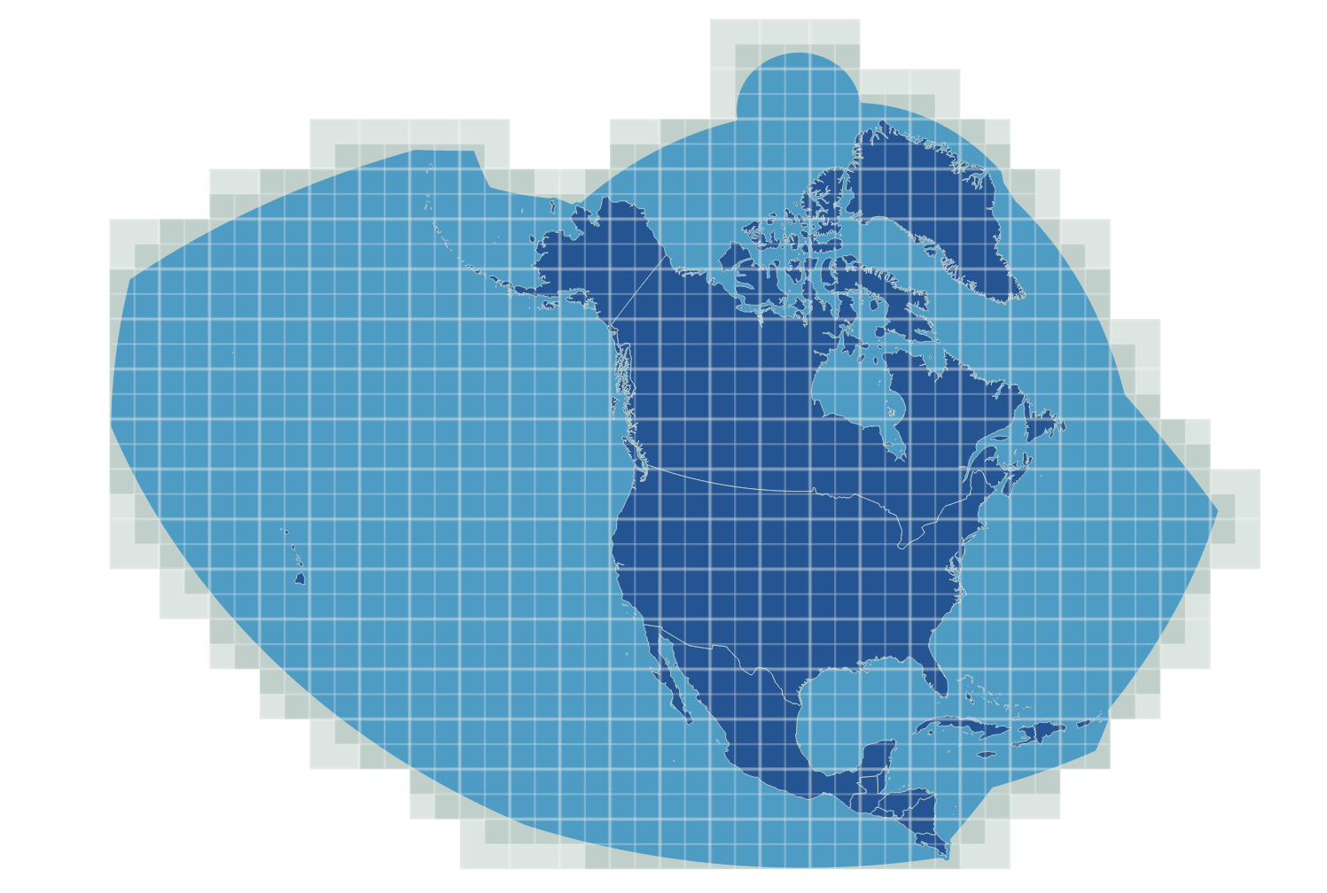
Equi7 Grid: Tiling: T3: 300km for 40m

Slide 8
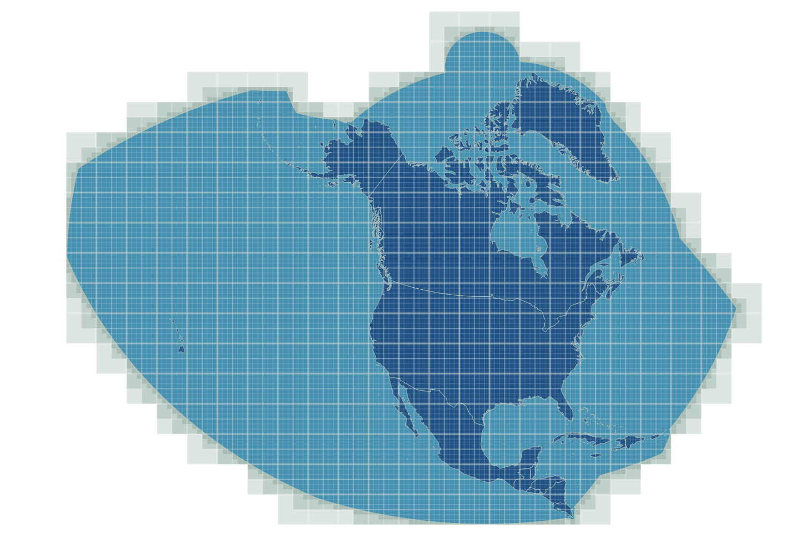
Equi7 Grid: Tiling: T1: 100km for 10/5m

